Slide 1
Label-free LOPIT with OOPS
Rayner Queiroz

Slide 2
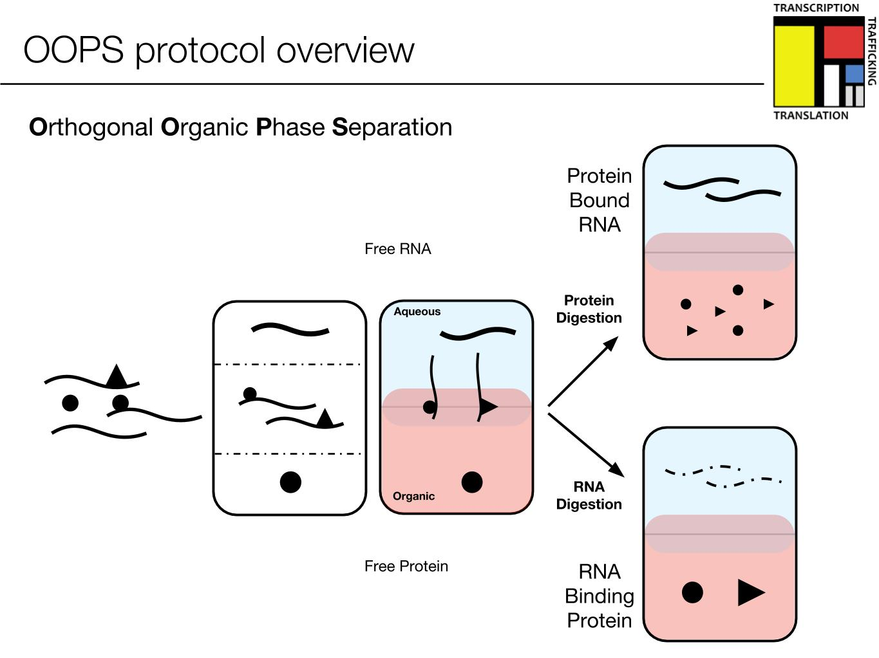
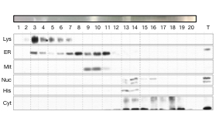
Experimental setup (Eneko/Rayner)
X 20 fractions
Q-Exactive Orbitrap

Slide 3
Raw data
~ 23,000 peptides after removing multi-mappers
Majority of them are missing values (average 85%)

Slide 4
Data processing steps (for imputing missing values)
Remove F1 & F2 as too few usable peptides
Remove all rows where >75% of values (15/20) are missing
Impute missing values using k-nearest neighbours (knn)
Aggregate peptides into proteins
Normalise using variance-stabilisation (vsn)
Add known markers (acknowledging that only a few will be bona fide RBPs)
Plot PCA and profile plots

Slide 5
Imputation
No imputation
nbavg for random missing value
imputation
QRILC for non-random missing value
imputation
Purple = Value exists, Yellow = Value is missing

Slide 6
Known markers
This includes all glycoproteins !!
Total proteins represented = 881

Slide 7
Known markers
Nucleus
60S Ribosome
ER
Plasma membrane
This includes all glycoproteins !!
Total proteins represented = 881

Slide 8
What about glycoproteins ? (Non-imputed values)
1130
831
Wide range of protein numbers
Total proteins = 2221
107
Later fractions less affected by glycoproteins

Slide 9
Future work
tRNA work : More replicates and extension of study with more data
Veronica’s Insulin treated MCF10A cells – to analyse TMT data and compare to label-free data
Vicky’s Tunicamycin/Thapsigargin data – to analyse TMT version of data
Label-free OOPS : Pursue imputed and non-imputed proteins for GO enrichment (preliminary results a bit confusing, so still trying to make sense of it)

